Slide 1

CAPSTONE project
CAPSTONE PROJECT
-Radhika Choudhary
-Robert Joseph

Slide 2

The Data Science Professional Certificate culminates with a capstone project where participants apply all the skills and knowledge gained from the nine courses. The final problem and analysis are open-ended, allowing learners to explore and decide on their own. Utilizing Foursquare's location data through its API, participants can create a unique problem to solve or compare cities and neighborhoods according to their preferences.
Introduction

Slide 3
In the dynamic landscape of technology and evolving industries, AI is poised to play a dominant role, reshaping the world as we know it. Amidst this backdrop, the question arises: Which of the two busiest cities in the world would be the ideal choice for starting an AI business? Factors such as pricing, multiculturalism, language barriers, and more will significantly impact this crucial decision-making process..
Business Problem

Slide 4
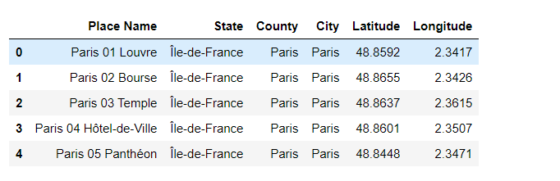
Data
Paris-Dataset Shown

Slide 5
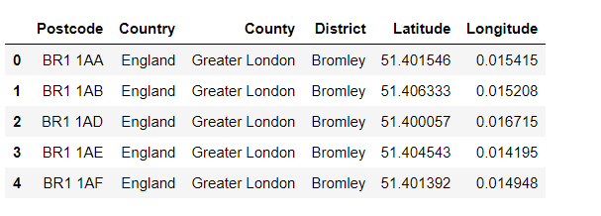
Data
London- Dataset shown below

Slide 6
Extensive research has been conducted on the dataset, delving into a comprehensive analysis of various features and methodologies to achieve the highest possible model accuracy. To streamline the data frame, certain features were replaced with more relevant data through a reduction process. Subsequently, cluster analysis was performed to identify the optimal clusters for both Paris and London. Further comparisons between the two cities were made using correlation and various visual graphs, providing valuable insights into their similarities and differences.
Methodology

Slide 7
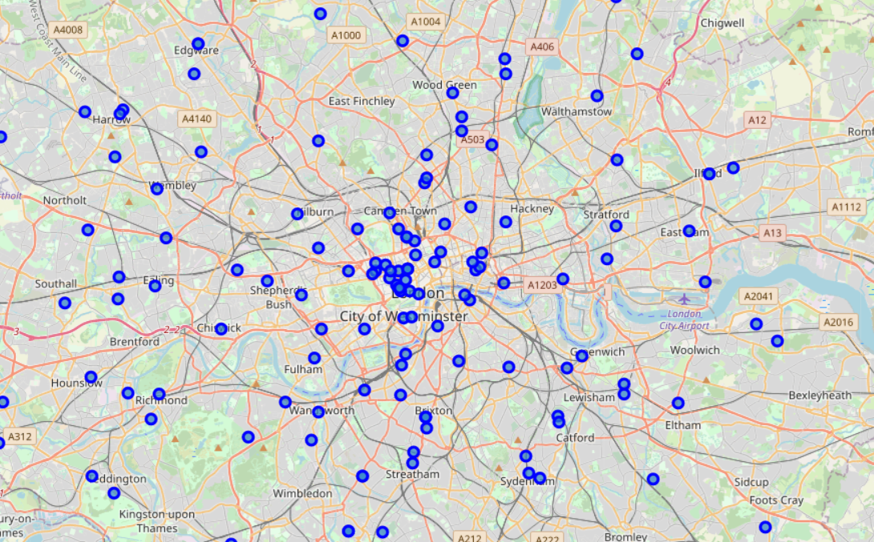
Let’s see the Map of London

Slide 8
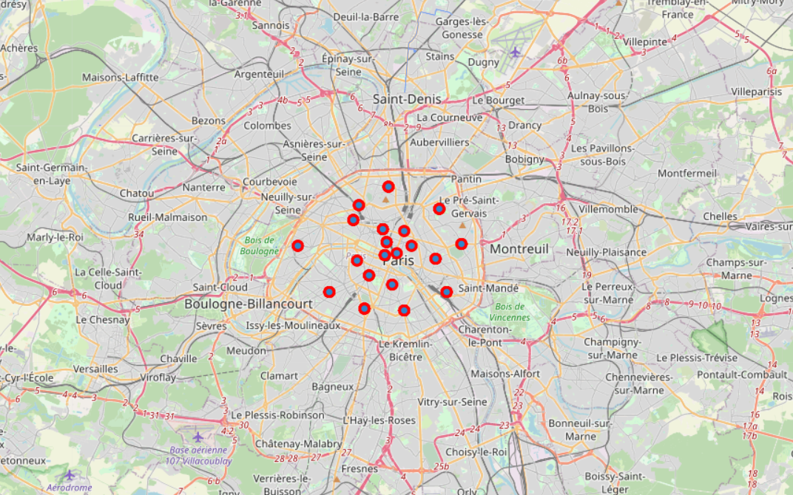
Let’s see the Map of Paris

Slide 9
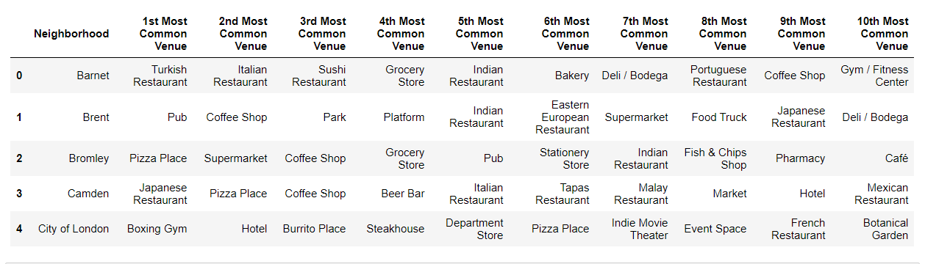
Venues
London-data displayed

Slide 10
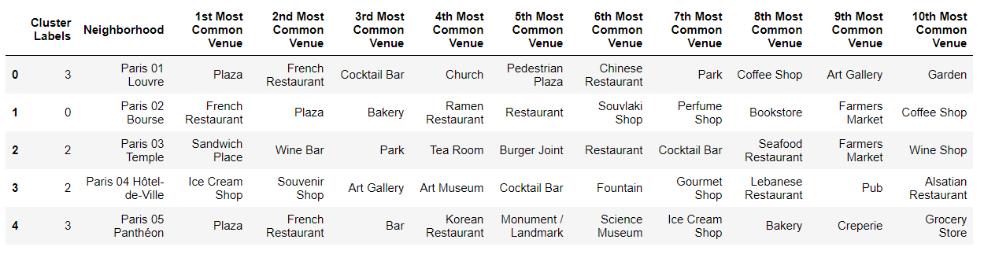
Venues
Data of Paris Displayed

Slide 11
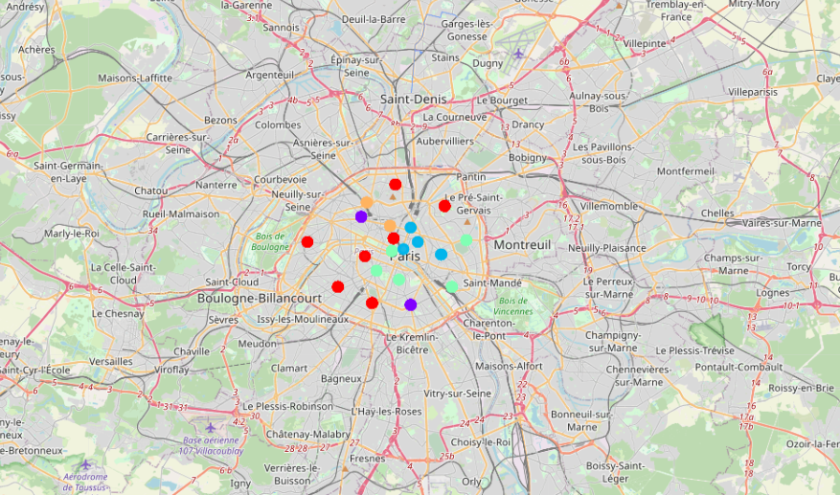
K Means Clustering Map - Paris

Slide 12
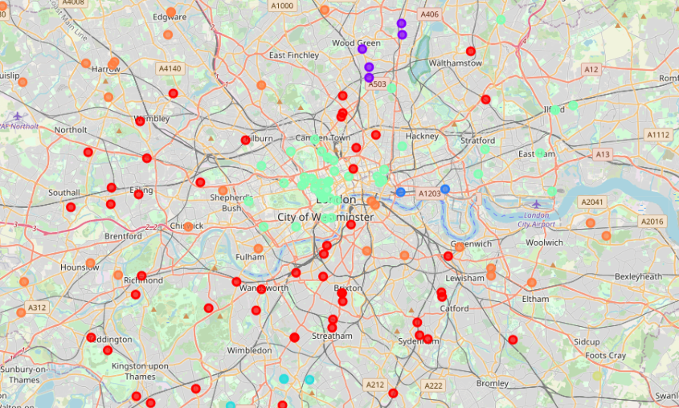
K Means Clustering Map - London

Slide 13
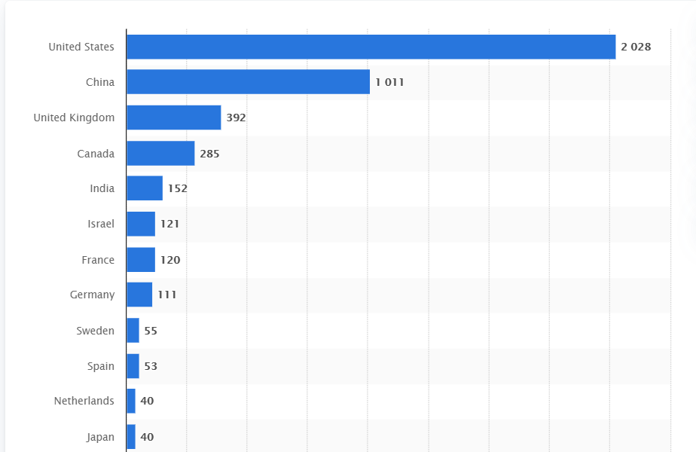
See the graph of Artificial Intelligence

Slide 14
Artificial Intelligence

Slide 15
Similarities: Both Paris and London stand out as multicultural and diverse cities, each with its unique cultural tapestry and historical significance. A common trend that emerges in both cities is the prevalence of restaurants as the topmost common venue in many renowned neighborhoods. Differences: Upon examining the city maps, a noticeable contrast surfaces between Paris and London in terms of their spatial layout. Paris appears more compact, facilitating convenient and unhindered pedestrian movement without excessive reliance on transportation. On the other hand, London exhibits a more sprawling urban landscape.
Results and Discussion

Slide 16
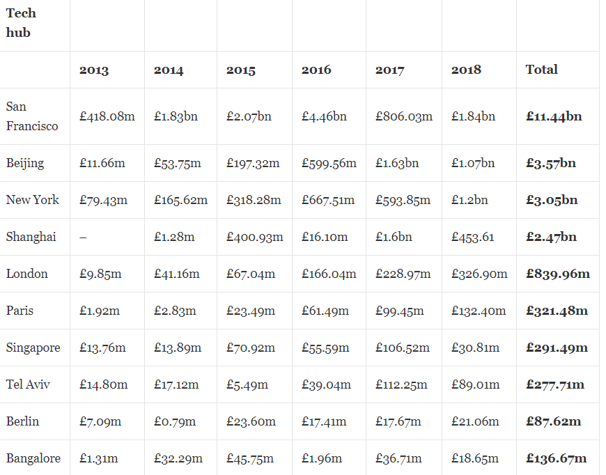
Artificial Intelligence
Results and Discussion

Slide 17
Artificial Intelligence The dataset for the Artificial Intelligence wasn't readily available and so had to be scrapped from multiple sources which often leads to inconsistency happening as well as errors. The districts have too complex geometry which would bring an error in our analysis if the venues are too close to each other. The data obtained through the API calls would return different results each time its called. Multiple trials and error runs are required to get the desired result.
Results and Discussion

Slide 18
Artificial Intelligence (AI) has emerged as a thriving and highly sought-after field, attracting increased investments from individuals and companies alike, prompting them to automate their operations. Both cities present a plethora of opportunities for those interested in investing in AI or establishing their AI-driven enterprises, as we have explored through various factors. Furthermore, the quest for a superior model led to the exploration of alternative methods and robust Machine Learning Algorithms like KD Tree, which significantly enhance runtime efficiency. Although clustering proved valuable in identifying optimal venues and areas, it's crucial to acknowledge that correlation does not imply causation. Consequently, any conclusions drawn from this analysis remain subject to change based on additional trends, diverse opinions, and alternative datasets.
Conclusion

Slide 19
APPENDIX
BY PRACTISING DATA SCIENCE COURSE LAB

Slide 20

This Photo by Unknown Author is licensed under CC BY

